Slide 1

Second Session of the UNEA – main elements and results so far
Natalia Alexeeva
Head of SRO for Central Asia,
26 May 2016

Slide 2
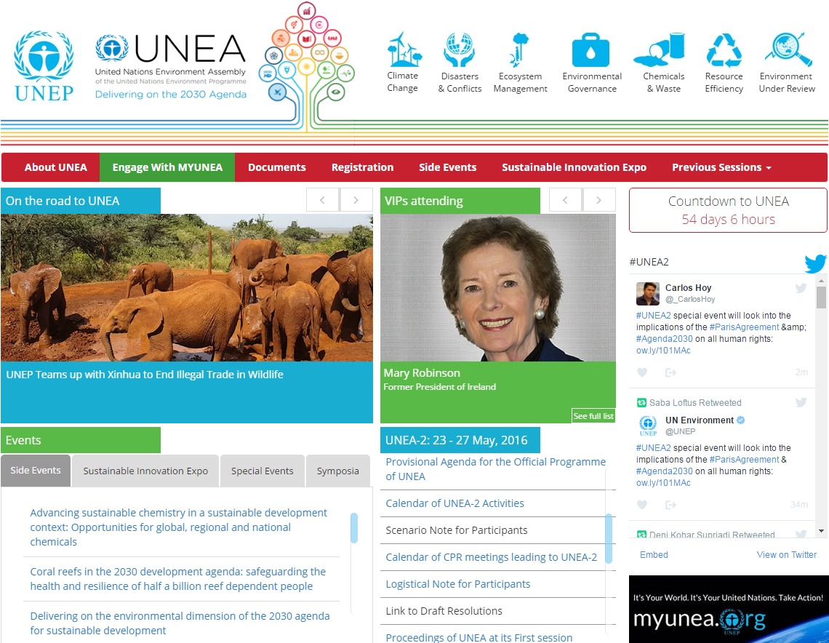
Notes:
During the last session of the CEP, we provided you with an update on the status of implementation of UNEA1 resolutions and the state of play in preparation for the UNEA Intersessional (the Second Session of the Open-Ended CPR - OECPR 2) to be held from 15-19 February 2016 in Nairobi, Kenya under the theme of Delivering on the environmental dimension of Agenda 2030.
The second meeting was held last week.
The meeting was attended by 405 participants from over 120 members and 3 observer missions including over 40 participants from major groups and stakeholders.
The meeting constructively reviewed and discussed 12 draft reports of the Executive Director pertaining to the implementation by UNEP of the Environment Assembly’s resolutions on issues ranging from illegal trade in wildlife to air quality and environmental law prepared in accordance with UNEA-1 resolutions and Governing Council decisions. The meeting anticipated minimum changes in these reports,which will be transmitted to all member States for consideration at UNEA-2 within established deadlines.

Slide 3
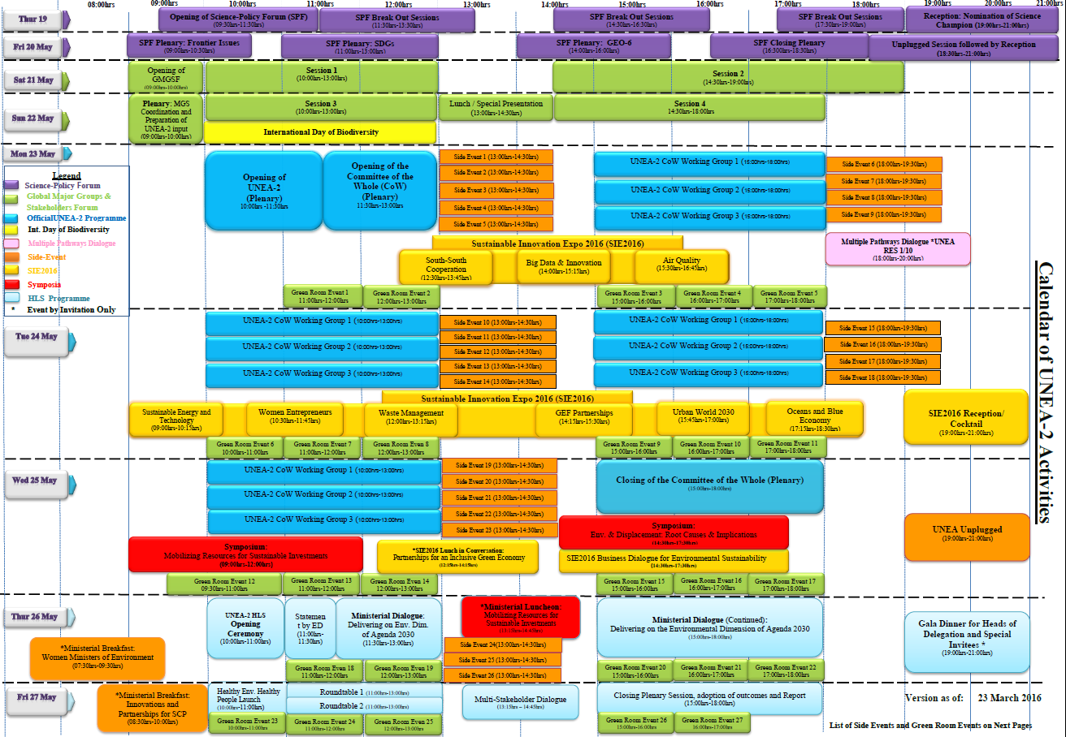
Proposed UNEA2 Structure
23-27 May 2016
Notes:
On the critical issue of the high-level segment outcome, while the divide remains between those who want a negotiated ministerial document and those who prefer a President’s summary, the OECPR was able to discuss the zero draft prepared on the basis of the elements received at the subcommittee level. It was agreed by participants to utilize the intersessional period until May to collect more inputs from member States and develop a short, concise and appealing document for further refinement in consultation with capitals.
On the organization of the high-level segment, the Chair informed the meeting of the agreement to convene a ministerial plenary on the overarching theme on Thursday May, 26 followed by a policy review session on Healthy Environment, Healthy People to be held in the morning of Friday 27th. This would be followed by a lunch-time multi-stakeholder dialogue on Friday, 27 May, the modalities for which were sent in due course to member States.

Slide 4

Proposed UNEA2 Structure
23-27 May 2016
Thur. 19- Wed 25 May 2016
Science-Policy Forum (SPF)
19-20 May 2016
Global Major Groups and Stakeholders Forum (GMGSF)
21-22 May 2016
International Day of Biodiversity
Side Events
Opening of
UNEA2
Opening of
Committee of the Whole (COW)
Side Events
UNEA2 COW
Working Groups
Side Events
Side Events
Side Events
Side Events
Side Events
Side Events
Side Events
Sustainable Innovation Expo 2016 (SIE 2016)
Green Room
Green Room
Green Room
Green Room
23-24 May 2016
UNEA2 CoW Working Groups
Side Events
Closing of CoW
Side Events
Symposium:
Env and Displacement
Side Events
Symposium: Mobilizing Resources for Sustainable Investments
Side Events
SIE 2016 Business Dialogue for Env Sus
Green Room
Side Events
Green Room
SIE 2016 Lunch in Conversation
Partnership for an Inclusive Green Economy
25 May 2016
Green Room
Green Room
Green Room
Green Room
Notes:
On the critical issue of the high-level segment outcome, while the divide remains between those who want a negotiated ministerial document and those who prefer a President’s summary, the OECPR was able to discuss the zero draft prepared on the basis of the elements received at the subcommittee level. It was agreed by participants to utilize the intersessional period until May to collect more inputs from member States and develop a short, concise and appealing document for further refinement in consultation with capitals.
On the organization of the high-level segment, the Chair informed the meeting of the agreement to convene a ministerial plenary on the overarching theme on Thursday May, 26 followed by a policy review session on Healthy Environment, Healthy People to be held in the morning of Friday 27th. This would be followed by a lunch-time multi-stakeholder dialogue on Friday, 27 May, the modalities for which were sent in due course to member States.

Slide 5
Proposed UNEA2 Structure
23-27 May 2016
Thur. 26 May 2016
UNEA2
High Level Segment
Ministerial breakfast: Women Ministers of Environment
Opening Ceremony;
ED statement
Ministerial Dialogue:
“Delivering on the environmental dimension of Agenda 2030 Agenda”
Gala dinner
Ministerial Luncheon: Mobilizing Resources for Sustainable Investments
Side Events
Side Events
Side Events
Green Room Events
Green Room Events
Green Room Events
Green Room Events
Green Room Events
Notes:
On the critical issue of the high-level segment outcome, while the divide remains between those who want a negotiated ministerial document and those who prefer a President’s summary, the OECPR was able to discuss the zero draft prepared on the basis of the elements received at the subcommittee level. It was agreed by participants to utilize the intersessional period until May to collect more inputs from member States and develop a short, concise and appealing document for further refinement in consultation with capitals.
On the organization of the high-level segment, the Chair informed the meeting of the agreement to convene a ministerial plenary on the overarching theme on Thursday May, 26 followed by a policy review session on Healthy Environment, Healthy People to be held in the morning of Friday 27th. This would be followed by a lunch-time multi-stakeholder dialogue on Friday, 27 May, the modalities for which were sent in due course to member States.

Slide 6
Proposed UNEA2 Structure
23-27 May 2016
Fri. 27 May 2016
UNEA2
High Level Segment
Ministerial breakfast: Innovations and Partnerships for SCP
Closing Plenary
Session, adoption of outcomes and Report
Healthy Environment Healthy People Launch
Multi-Stakeholder
Dialogue
Roundtable 1
Roundtable 2
Green Room Events
Green Room Events
Green Room Events
Green Room Events
Green Room Events
Notes:
policy review session on Healthy Environment, Healthy People to be held in the morning of Friday 27th. This would be followed by a lunch-time multi-stakeholder dialogue on Friday, 27 May, the modalities for which were sent in due course to member States.

Slide 7

Two background documents for the High Level Segment ministerial discussions:
  The concept note on “Delivering on the environmental dimension of the 2030 Agenda for Sustainable Development”, and
  The draft report on “Healthy environment, healthy people”
Notes:
In addition, participants positively regarded two important documents – the concept note on “Delivering on the environmental dimension of the 2030 Agenda for Sustainable Development”, and the draft report on “Healthy environment, healthy people” – which will underpin the ministerial discussion at UNEA2.
In this context a ministerial panel was organized on Wednesday, February 17 to discuss the findings and recommendations of these documents, which demonstrated their policy relevance and paved the way for more effective engagement by Ministers at UNEA-2.

Slide 8
Draft resolutions and decisions
of the second session of the United Nations Environment Assembly (UNEA-2)
Compilation of the clusters of resolutions
as of 15 March 2016
Notes:
The meeting considered more than 20 proposals (next few slides showing clusters of resolutions), some new such as on oceans and environmental protection in conflict areas and others follow-up to previous decisions and resolutions of the UNEP governing body.
Through hard work undertaken in two parallel negotiation sessions, the CPR made a significant progress in completing the reading of all resolutions and agreed to continue working on these resolutions in the CPR subcommittee during the intersessional period.
In this process, we will keep in mind the collective preference to have a fewer number of impactful resolutions for consideration by UNEA-2.

Slide 9
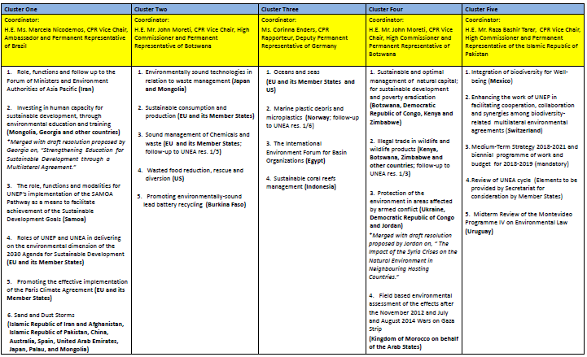
Notes:
The meeting considered more than 20 proposals (next few slides showing clusters of resolutions), some new such as on oceans and environmental protection in conflict areas and others follow-up to previous decisions and resolutions of the UNEP governing body.
Through hard work undertaken in two parallel negotiation sessions, the CPR made a significant progress in completing the reading of all resolutions and agreed to continue working on these resolutions in the CPR subcommittee during the intersessional period.
In this process, we will keep in mind the collective preference to have a fewer number of impactful resolutions for consideration by UNEA-2.

Slide 10

Delivering on the environmental dimension
of the 2030 Agenda
for Sustainable Development
23-27 May 2016
UNEA-2 will be enriched by :
2 Symposia (25 May):
  Mobilizing Resources for Sustainable Investments”, and
  “Displacement, Environment and Root Causes”
This is followed by a ministerial luncheon (26 May) entitled “Mobilizing Resources for Sustainable Investments” to allow Ministers and other high-level participants to have a dialogue on the key findings of the symposia.
Notes:
In addition to the plenary sessions, and side events, UNEA will also have 2 symposia:
The aims of the proposed symposia on displacement are threefold:
- to focus attention of policy makers on various dimensions of environmental degradation and forced migration, both at present and in the future under current projections of climate change and land degradation, in the context of the 2030 agenda and as ‘bridge’ between the humanitarian and development spheres;
- To use UNEP’s convening power to bring together leading agencies, initiatives and governments concerned about the links between forced migration and the environment for a discussion on shared priorities and concrete next steps (without UNEP presenting a ‘manifesto’ itself); and,
- To draw a link between the World Humanitarian Summit (Istanbul 23-24 May 2016) and UNEA and to discuss possible areas for increased collaboration between UNEP and humanitarian organizations.

Slide 11
Delivering on the environmental dimension
of the 2030 Agenda
for Sustainable Development
23-27 May 2016
UNEA-2 will be enriched by :
Science-Policy Conference
Global Major Groups and Stakeholders Forum
Celebration of the International Day of Biodiversity
Sustainable Innovation Expo (SIE2016)
  Air quality
  Blue economy
  Energy
  Gender
  Information
  Looking to 2030: Building coalitions of Global Commons
  South-South Cooperation
  Urbanization
  Waste
26 side events
27 Green Room side events
Notes:
Sustainability Innovation Expo (SIE2016) will be held in parallel to the Assembly to allow various stakeholders, including representatives of the business community, UN organization and other Major Groups and Stakeholders to take part in focused thematic discussions and exhibition events.
Green Room side events take place in a dedicated meeting room (“the Greenroom”), primarily for civil society, with a view to sharing experiences and increasing opportunities for informal dialogue among the participants of UNEA-2.
In addition, there will be a Science-Policy Conference, celebration of the International Day of Biodiversity, and the Global Major Groups and Stakeholders Forum to be held prior to UNEA-2.

Slide 12
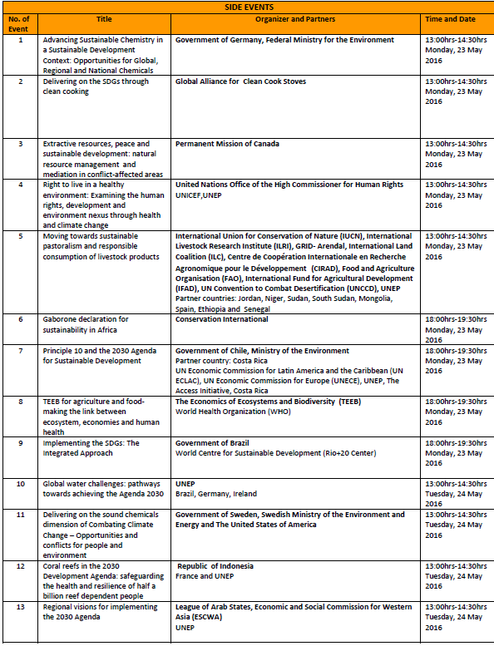
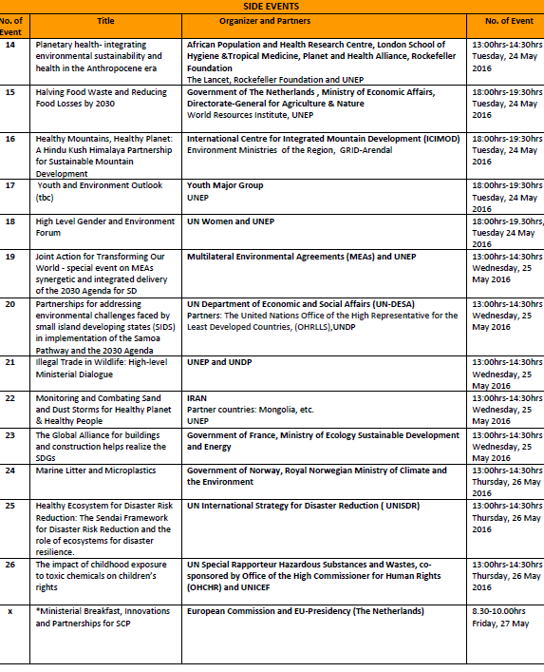
Proposed UNEA2 Structure
23-27 May 2016
Notes:
On the critical issue of the high-level segment outcome, while the divide remains between those who want a negotiated ministerial document and those who prefer a President’s summary, the OECPR was able to discuss the zero draft prepared on the basis of the elements received at the subcommittee level. It was agreed by participants to utilize the intersessional period until May to collect more inputs from member States and develop a short, concise and appealing document for further refinement in consultation with capitals.
On the organization of the high-level segment, the Chair informed the meeting of the agreement to convene a ministerial plenary on the overarching theme on Thursday May, 26 followed by a policy review session on Healthy Environment, Healthy People to be held in the morning of Friday 27th. This would be followed by a lunch-time multi-stakeholder dialogue on Friday, 27 May, the modalities for which were sent in due course to member States.

Slide 13
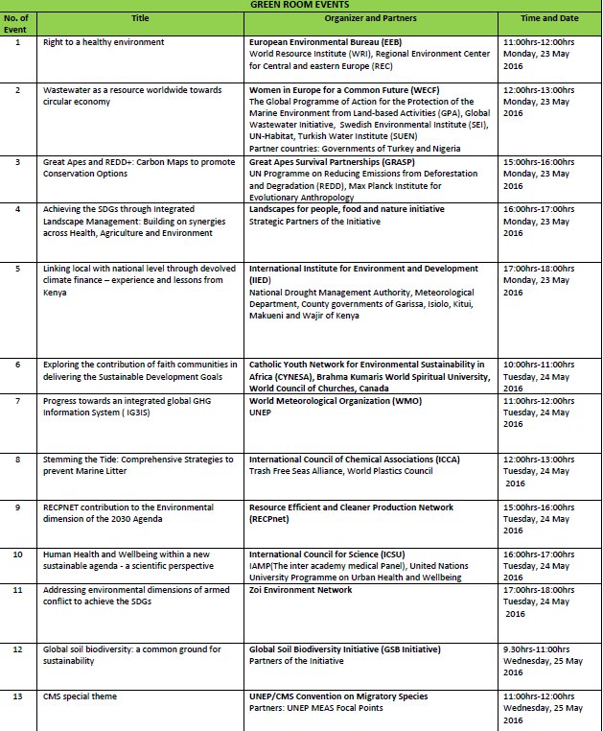
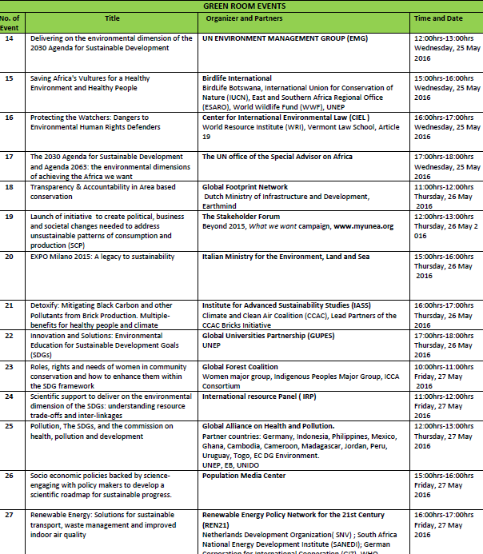
Proposed UNEA2 Structure
23-27 May 2016
Notes:
On the critical issue of the high-level segment outcome, while the divide remains between those who want a negotiated ministerial document and those who prefer a President’s summary, the OECPR was able to discuss the zero draft prepared on the basis of the elements received at the subcommittee level. It was agreed by participants to utilize the intersessional period until May to collect more inputs from member States and develop a short, concise and appealing document for further refinement in consultation with capitals.
On the organization of the high-level segment, the Chair informed the meeting of the agreement to convene a ministerial plenary on the overarching theme on Thursday May, 26 followed by a policy review session on Healthy Environment, Healthy People to be held in the morning of Friday 27th. This would be followed by a lunch-time multi-stakeholder dialogue on Friday, 27 May, the modalities for which were sent in due course to member States.

Slide 14
Proposed UNEA2 Structure
23-27 May 2016
Why it is important to be at UNEA?
By joining the high-level plenary and ministerial sessions, you can:
  provide UNEP and the environmental community around the world a direction on how to achieve the implementation of the environmental dimension of the 2030 Agenda
  identify concrete partnerships, policies and tools that can facilitate achievement of the SDGs
  share your experiences on how to integrate the environmental dimension of sustainable development into national planning processes, and build capacity to track progress.
Through the UNEA-2 Outcome Document and the set of resolutions to be adopted in the end of UNEA-2, you will help to set a collective vision for the future of the environmental agenda.
UNEA offers a market of solutions, inspiration, guidance, information and new contacts and partnerships with other environment ministers of the world and much beyond

Slide 15
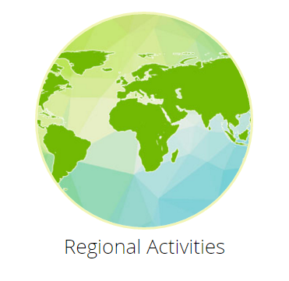

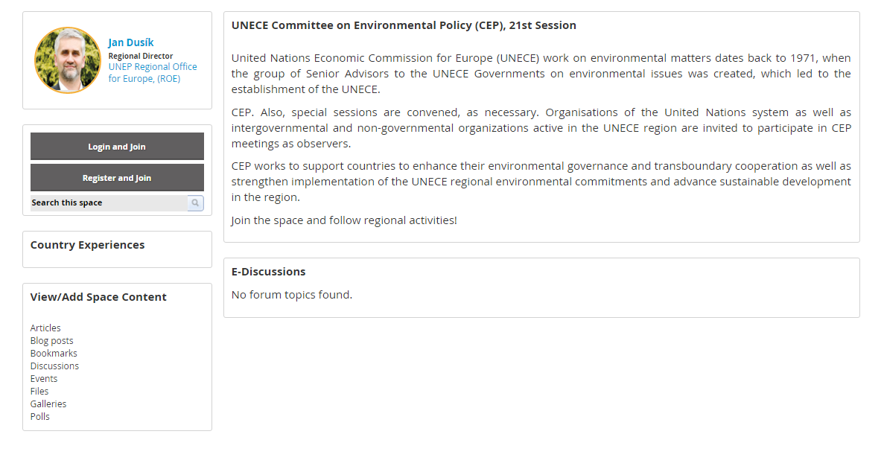
Delivering on the environmental dimension
of the 2030 Agenda
for Sustainable Development
23-27 May 2016
MyUNEA.org is intend to be a
citizen-engagement platform
A new Opportunity
For multi-stakeholder
Engagement with
UNEP and UNEA
Join@: https://www.myunea.org
Notes:
MyUNEA is:
A user-friendly, moderated, inter-active, online hub hosted by UNEP, with the aims to:
Increase peoples’ participation in the UNEA
Engage with a broad audience and increase peoples’ participation in the UNEA
This includes:
Information resources and link to UNEP Live
Thematic E-Discussions spaces to allow people to have a say in the global thematic report "Healthy Environment - Healthy People” being prepared for UNEA-2
Built on relevant examples
Multi-stakeholder initiatives in the context of the post-2015 development agenda
Experience of the portal created for UNEA-1
Other online resources within UNEP, such of UNEP-Live

Slide 16

Proposed UNEA2 Structure
23-27 May 2016
UNEA results so far
Over 2000 participants, 170 nations, and hundreds of stakeholders from governments, businesses and civil society are attending UNEA 2.
Participants include Kenya’s President Uhuru Kenyatta, Iran's vice-president, Ireland's former president Mary Robinson, the director-general of the World Wildlife Fund, the political director of Greenpeace, the CEO of Kiira Motors and government ministers from across the globe, including French Ecology Minister Ségolène Royal.
With its wide reach into the legislative, financial and development arenas, the body presents a ground-breaking platform for leadership on global environmental policy.
A new UNEA President was elected at the
opening session.
H.E. Edgar Gutiérrez Espeleta is
the Minister of Environment and Energy of Costa Rica.

Slide 17

Proposed UNEA2 Structure
23-27 May 2016
UNEA results so far – cont.
Science-Policy Forum 19–20 May 2016
Forum was opened by Mr. Achim Steiner, Under-Secretary-General of the United Nations and Executive Director of UNEP.
On the first day the Forum tackled a number of topics, including the following:
• Sustainable consumption and production; resource efficiency
• Marine: Identifying policy options and targeted information to address ocean and coastal degradation as a prerequisite for sustainable development
• Food-energy-water nexus
• Natural capital
• Addressing secondary impacts in the extractive sector: the contribution of REDD+ and forest data
• Climate change, air quality, sand and dust storms.
The Forum also recognized the contribution of outstanding individuals in the field of environment, science and policy.

Slide 18
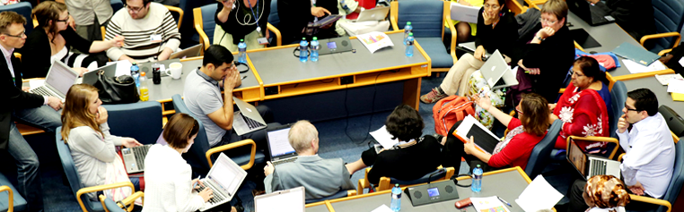
Proposed UNEA2 Structure
23-27 May 2016
UNEA results so far – cont.
16th Global Major Groups and Stakeholders Forum (21 and 22 May 2016) is a platform for exchange among various stakeholders – Governments, major civil-society groups, scientist and the private sector – and is organized by the major groups and stakeholders themselves with the assistance of UNEP.
The first day of the Forum included sessions on the status of negotiations at UNEA and the expected outcome; on main UNEA themes; the role of major groups and stakeholders in multistakeholder partnerships; and policymaking and the application of the rule of law in implementing the Sustainable Development Goals.
The second day focused mainly on the preparation of input and positions of major groups and stakeholders into key UNEA themes, resolutions and decisions.
The results of those discussions
were consolidated into
statements and positions that
the major groups will use for
their interventions during
UNEA and in discussions with
Member States.

Slide 19
Proposed UNEA2 Structure
23-27 May 2016
UNEA – ongoing discussions
The Committee of the Whole agreed on the roles of the drafting groups, which are now engaged in negotiations on the various draft resolutions. Discussions are focused on a number of resolutions, with work on some of them continuing later in the drafting groups.
The Ministerial session starts on 26th May, Thursday, delivering the environmental dimension and going on 27th May, Friday and coming up with the policy review. The decision on the draft resolutions would come out on Friday
UNEA 2 live streams on our YouTube channel http://bit.ly/1SNyI8b.
UNEA information is also available via a handy mobile app that also sends you notifications/alerts/announcements/ updates. The app is free of charge and is easy to download and install on Android and Apple devices – just look for the UNEP Events app at Google Play Store or iTunes App Store.
You can also engage with UNEP and others on social media via #UNEA2.
Twitter • UNEPinEurope
Facebook • unep.org
Youtube • unepandyou

Slide 20
Delivering on the environmental dimension
of the 2030 Agenda
for Sustainable Development
23-27 May 2016
Thank you.

